Slide 1
THANKSGIVING
San Diego Bible Students Convention
Bro. Richard Doctor
November 9, 2012

Slide 2
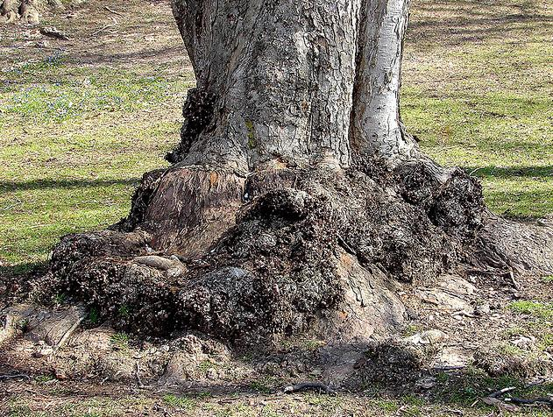
Colossians 2:7 “Rooted and built up in him, and stablished in the faith, as ye have been taught, abounding therein with thanksgiving.”

Slide 3
Psalm 69:30 I will praise the name of God with a song, and will magnify him with thanksgiving
Our Thanksgiving may be of two types:
Quiet reflective and mindful prayer
The voice of praise

Slide 4
Psalm 69:30 I will praise the name of God with a song, and will magnify him with thanksgiving
Our Thanksgiving may be of two types:
Quiet reflective and mindful prayer
The voice of praise

Slide 5
Is there a method for cultivating mindfulness in our Christian lives?

Slide 6
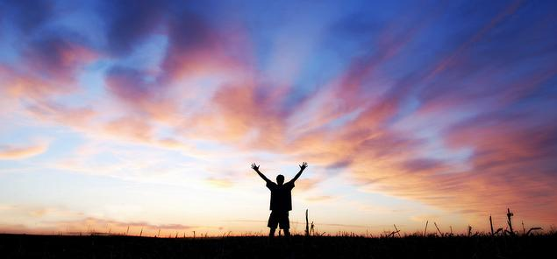
The one we may choose is gratefulness and thanksgiving , which can be practiced, cultivated, learned.

Slide 7
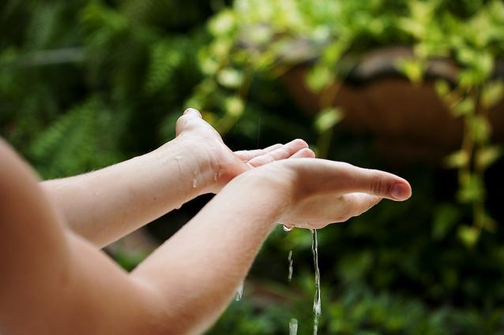
Four Point linked to Thanksgiving
Acknowledgement
Confession
Vision of the Holy
Thanksgiving in our voice

Slide 8
Consider the prayer of Jonah Chapter 2

Slide 9
The prayer of Jonah
“This prayer holds a type of the history of the nation of Israel since Jesus left their house desolate.” (R.92:5)
The belly of the fish is also the type of our Lord’s time spent in death (Matthew 12:40)

Slide 10
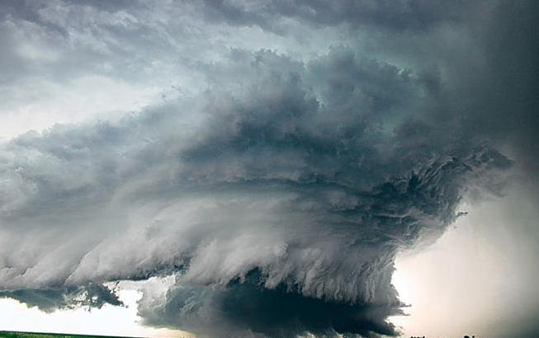
Jonah surely was in the midst of trial and the storms of life. He was fleeing God because Jonah was upset with God.

Slide 11
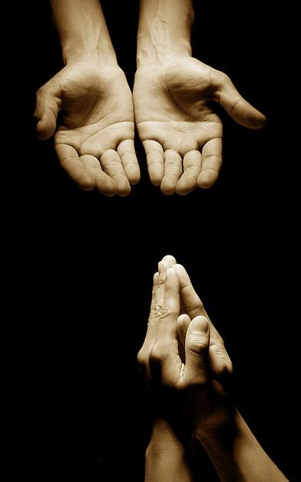
Then Jonah prayed unto the LORD his God out of the fish's belly, And said, I cried by reason of mine affliction unto the LORD, and he heard me; out of the belly of hell cried I, and thou heardest my voice.

Slide 12
For thou hadst cast me into the deep, in the midst of the seas; and the floods compassed me about: all thy billows and thy waves passed over me.

Slide 13
Then I said, I am cast out of thy sight; yet I will look again toward thy holy temple.

Slide 14
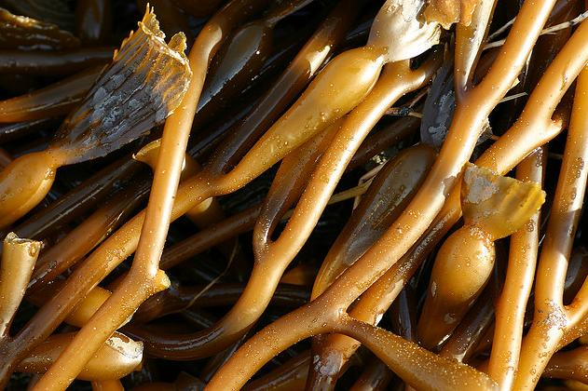
The waters compassed me about, even to the soul: the depth closed me round about, the weeds were wrapped about my head..

Slide 15
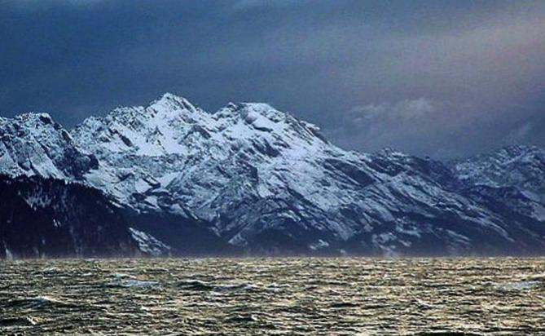
I went down to the bottoms of the mountains; the earth with her bars was about me for ever: yet hast thou brought up my life from corruption, O LORD my God.

Slide 16
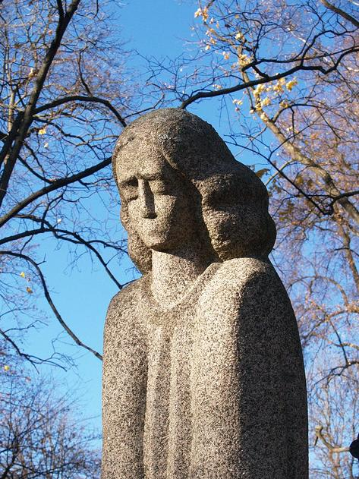
When my soul fainted within me I remembered the LORD: and my prayer came in unto thee, into thine holy temple.

Slide 17
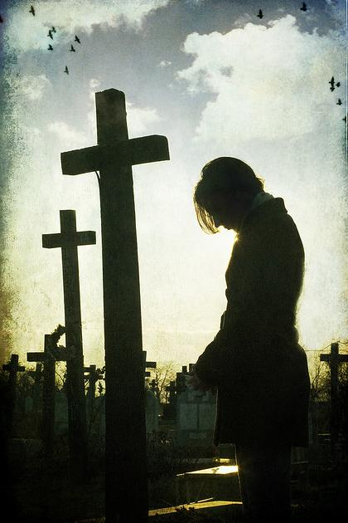
They that observe lying vanities forsake their own mercy. But I will sacrifice unto thee …

Slide 18
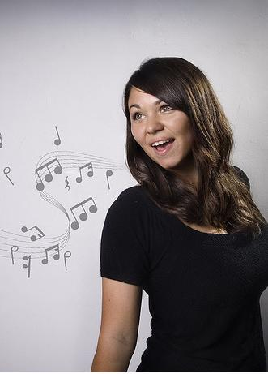
with the voice of thanksgiving; I will pay that that I have vowed. Salvation is of the LORD.

Slide 19
Four Point linked to Thanksgiving
Acknowledgement
Confession
Vision of the Holy
Thanksgiving in our voice

Slide 20
1-Thanksgiving should be preceded by acknowledging our Heavenly Father and preparing our hearts

Slide 21
Then Jonah prayed unto the LORD his God out of the fish's belly, And said, I cried by reason of mine affliction unto the LORD, and he heard me; out of the belly of hell cried I, and thou heardest my voice.

Slide 22
2-Thanksgiving should be preceded by confessing our sins to God

Slide 23
Then Jonah prayed unto the LORD his God out of the fish's belly, And said, I cried by reason of mine affliction unto the LORD, and he heard me; out of the belly of hell cried I, and thou heardest my voice.

Slide 24
3- Thanksgiving - Especially, in the midst of trials we should envision the holy

Slide 25
Then I said, I am cast out of thy sight; yet I will look again toward thy holy temple.

Slide 26
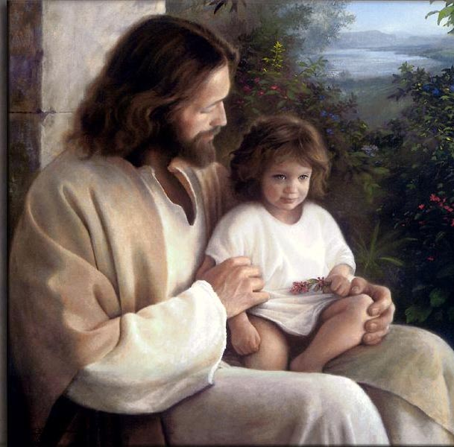
4-Thanksgiving should flow from our hearts and to our voice

Slide 27
with the voice of thanksgiving; I will pay that that I have vowed. Salvation is of the LORD.

Slide 28
Jonah must have paid his vow.
Salvation is of the LORD

Slide 29
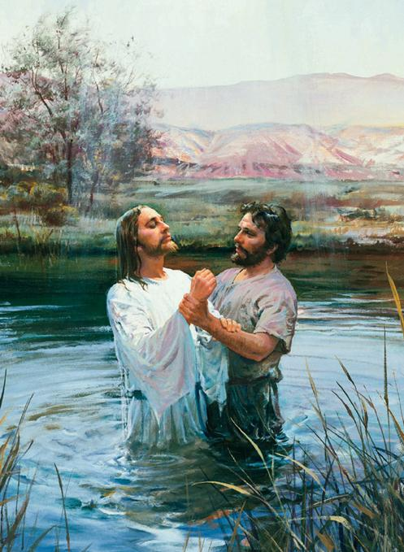
Psalm 50:14 “Offer unto God thanksgiving; and pay thy vows unto the most High”

Slide 30
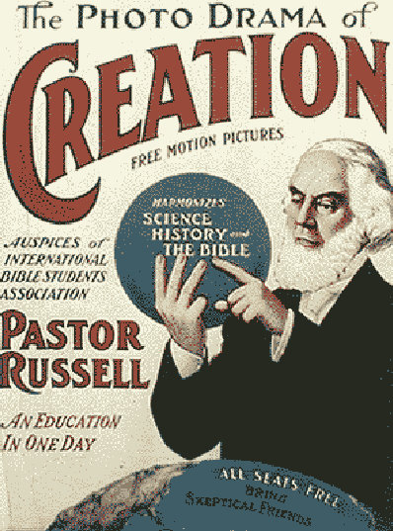
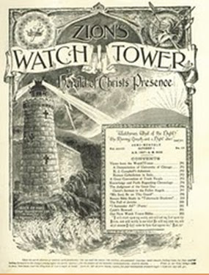
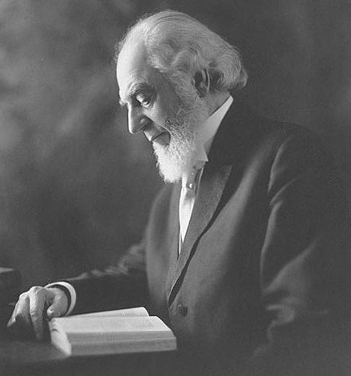
Psalm 107:22 “…sacrifice the sacrifices of thanksgiving, and declare his works with rejoicing.”

Slide 31
Philippians 4:6 Be careful for nothing; but in every thing by prayer and supplication with thanksgiving let your requests be made known unto God.

Slide 32
Psalm 147:7 “Sing unto the LORD with thanksgiving; sing praise upon the harp unto our God”

Slide 33
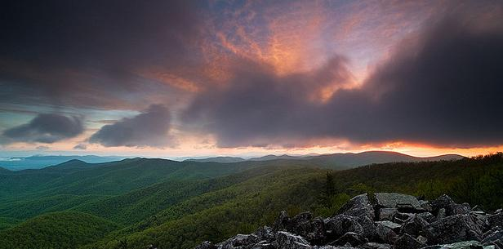
With our waking thoughts and prayers
As our eyes greet the morning, we may remind ourselves that we have eyes to see while millions of our human brothers and sisters are blind in their literal sight – and billions in their spiritual sight.

Slide 34
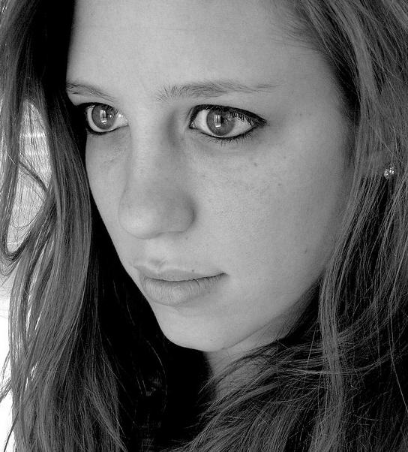
When we then open our eyes with this thought, chances are that we will be more grateful for the gift of sight and more alert to the needs of those who lack that gift.

Slide 35
Oh that we could open the eyes of the world to the fulfillment of their unspoken hopes. Christ is come! This is true cause for Thanksgiving

Slide 36
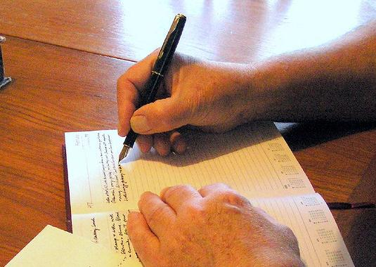
Before turning off the light in the evening, we may jot down one thing for which we never before have given grateful thanksgiving.

Slide 37
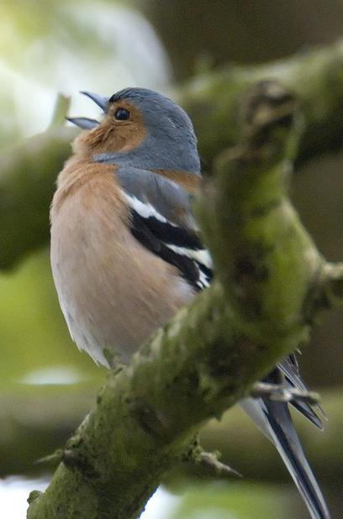
One of the Lord’s dear ones has done this for years, and testifies that the supply still seems inexhaustible.

Slide 38
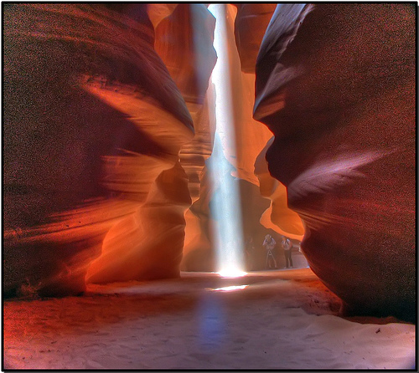
Gratefulness brings joy life. Once we stop “taking for granted,” there is no end to the surprises and delight we may find.

Slide 39
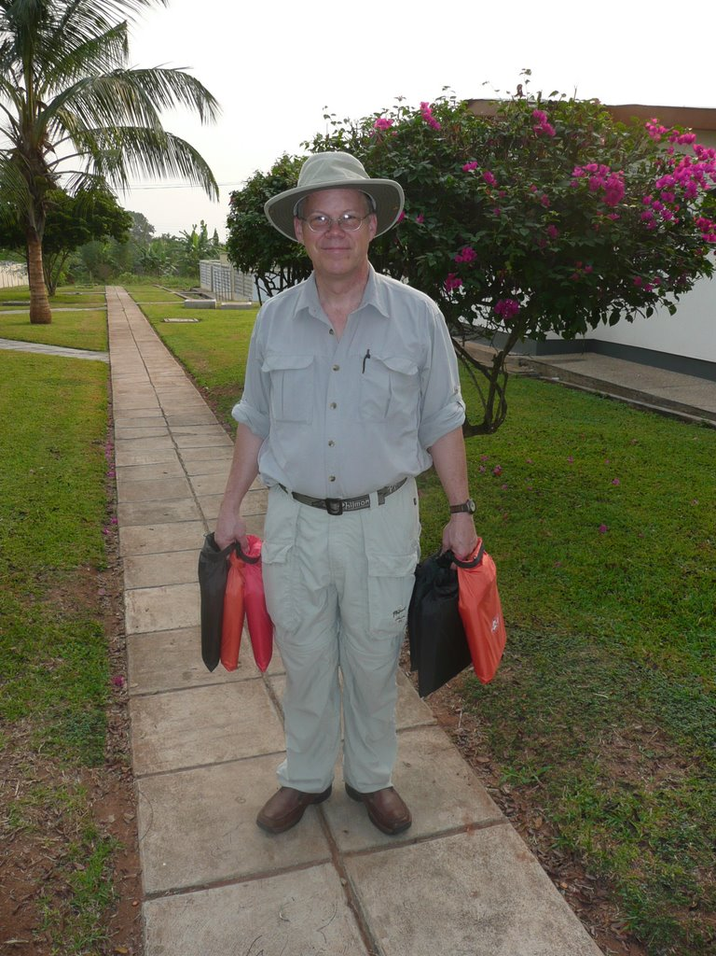
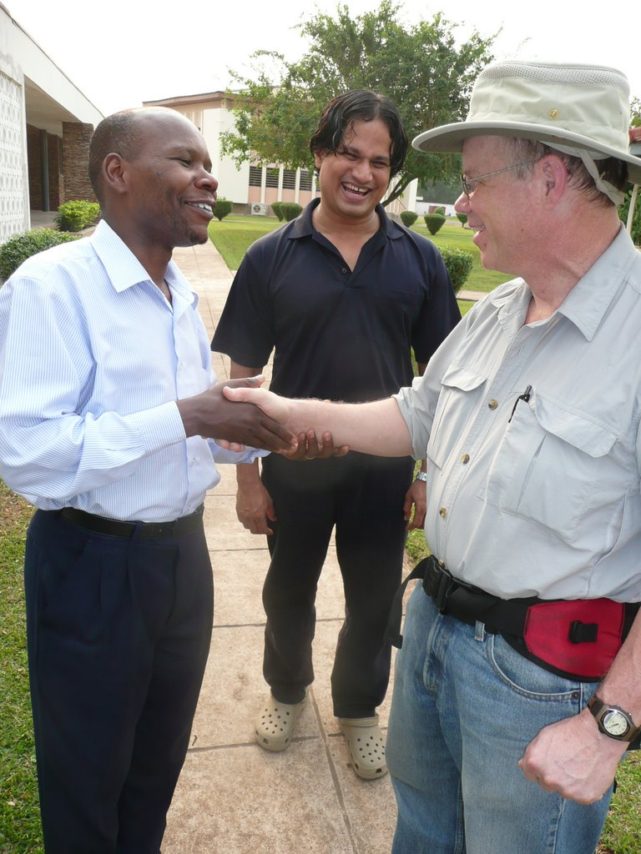
A grateful attitude is a creative one, and a giving one
GHANA Jan 2010 - Meeting of
3 world cultures
GHANA Jan 2010 - Bob Goodman delivering DVD players

Slide 40
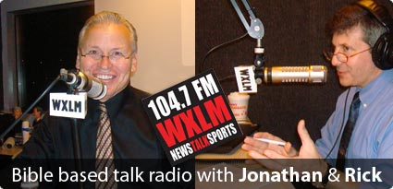
because, in the final analysis, opportunity is the gift within the gift of every moment

Slide 41
The opportunity to see and hear and smell and touch and taste with pleasure. Everything is a gift.

Slide 42
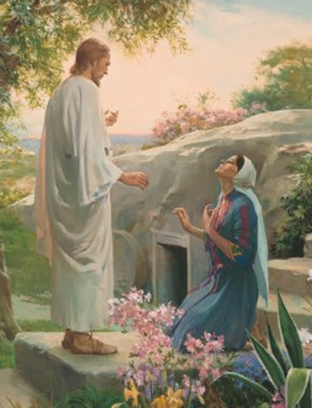
As we consider what God has done, There is no more joyful bond than the one that gratefulness celebrates, the bond between our Heavenly Father – the giver, and we – the thanksgivers.

Slide 43
As St. Paul assured his beloved brethren in Corinth, thanksgiving leads to liberality and sharing of God’s gifts concluding his thoughts with: “Thanks be to God for His unspeakable gift!” 2 Corinthians 9:15

Slide 44
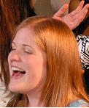
Psalm 26:7 “[Oh] That I may publish with the voice of thanksgiving, and tell of all thy wondrous works.”
“Thy Kingdom Come…”

Slide 45
A Harmony with the Chart of the Ages

Slide 46
May the Lord add His Blessing

