Slide 1
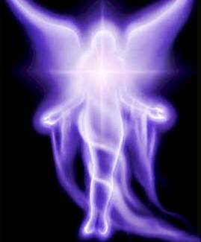
An Angel of Light

Slide 2
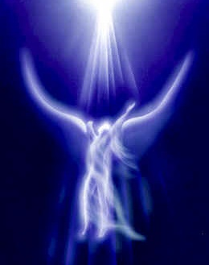
2 Corinthians 11:14
And no marvel; for Satan himself is transformed into an angel of light.
Transformed: Strong’s 3345
To transfigure or disguise.

Slide 3
Romans 12:2
And be not conformed to this world: But be ye transformed by the renewing of your mind, that ye may prove what is that good, acceptable, and perfect will of God.
Transformed: Strong’s 3339
Transform or metamorphose.

Slide 4
Why the disguise?
Isaiah 14:13-14 KJV For thou (Lucifer) hast said in thine heart, I will ascend into heaven, I will exalt my throne above the stars of God: I will sit also upon the congregation, in the sides of the north: I will ascend above the heights of the clouds; I will be like the most High.
like

Slide 5
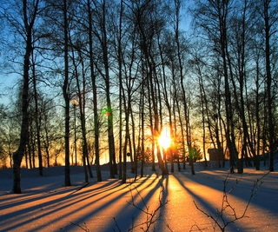
1 John 1:5
This then is the message which we have learned of him, and declare unto you, that God is light, and in him is no darkness at all.
Satan needed to copy or emulate God, he needed to appear as God, he needed to appear as an angel of light.

Slide 6
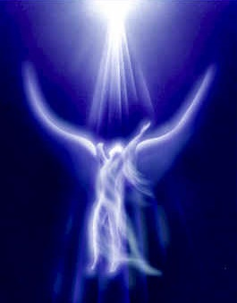
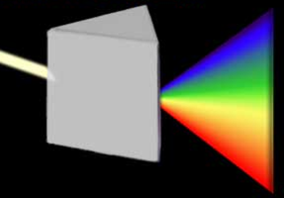
Satan assumed he would ascend to the same level as God
But he did not want to use the whole spectrum of light
He transformed by disguising himself rather than changing himself

Slide 7
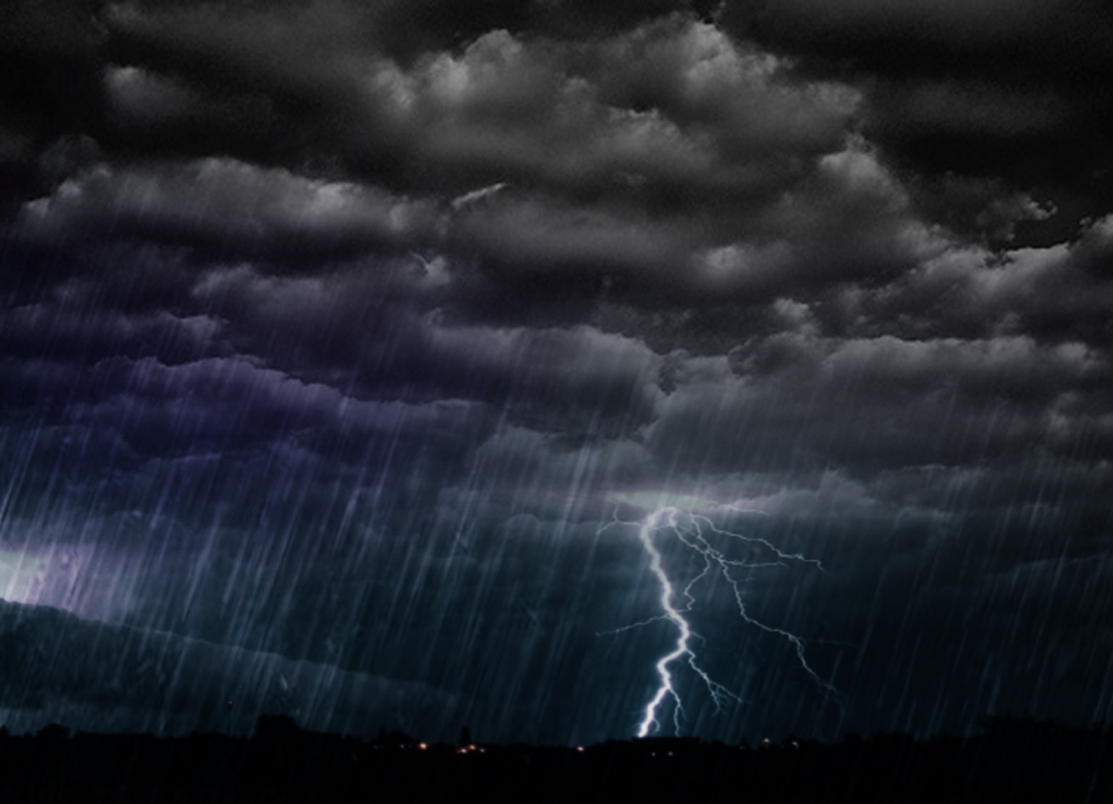
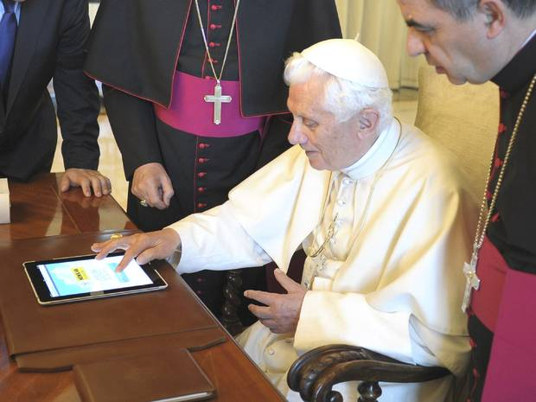
Satan felt he had the wisdom of God
What he wanted was the Power of God

Slide 8
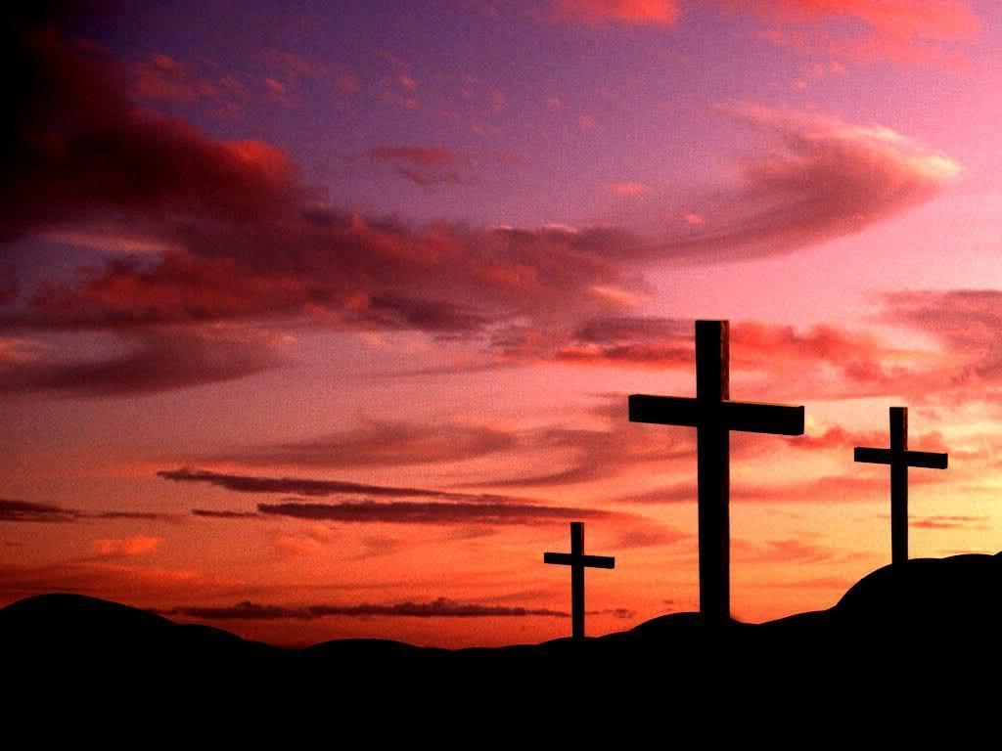
Satan was not interested in emulating:
God’s Love
God’s Mercy
God’s Justice
God’s Patience

Slide 9
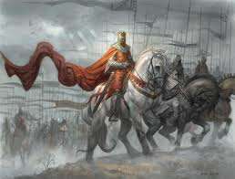
Satan knew he was more powerful than humans:
Power to coerce
Power to control
He Really Wanted to Rule Over Mankind

Slide 10
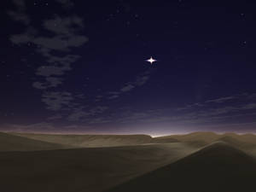
Definition of Lucifer:
The morning star, in the sense of brightness
Why the Disguise?
Greed

Slide 11
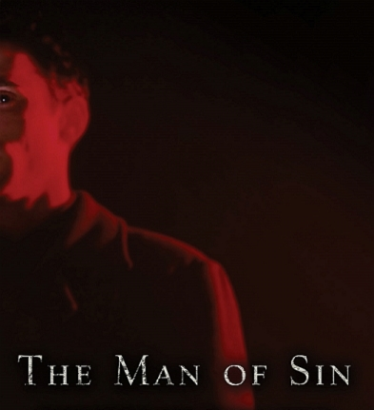
1 John 4:3
…and this is that spirit of antichrist, whereof ye have heard that it should come; and even now already is it in the world.

Slide 12
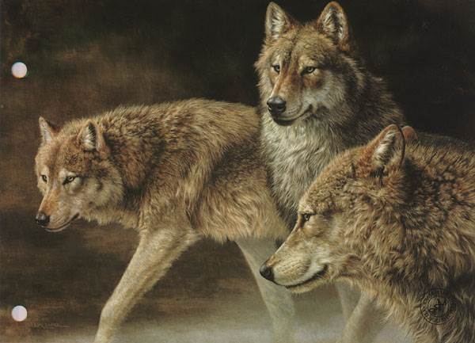
Acts 20: 29 & 30
…after my departing shall grievous wolves enter in among you, not sparing the flock. Also of your own
selves shall men arise, speaking perverse things, to draw away disciples after them.

Slide 13
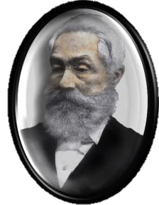
Reverend J. A. Wylie 1808-1890
“THE PAPACY: Its History, Dogmas, Genius, and Prospects”

Slide 14
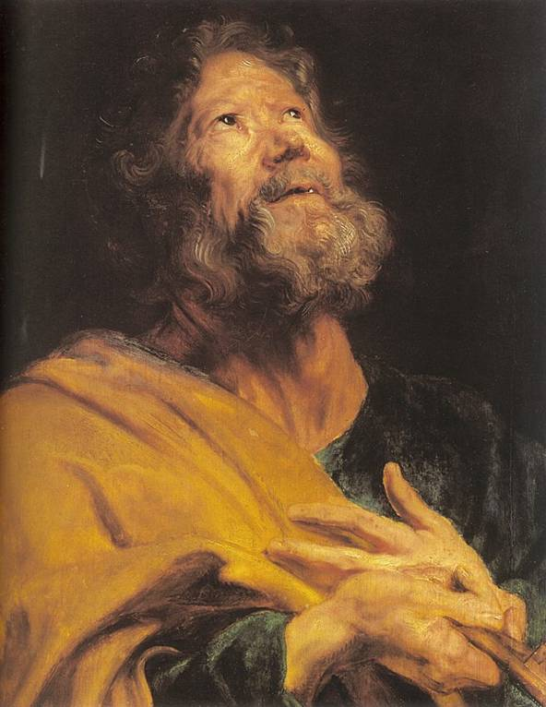
First Papal pastors equal with brethren
Watched the flock with love
No worldly ambitions
Disseminated Christianity with zeal
Advice was paternal, no superiority implied

Slide 15
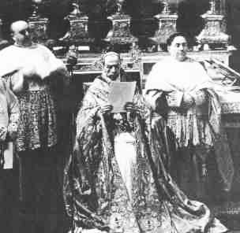
Eventually the Episcopate at Rome was held by men of worldly spirit – lovers of preeminence
At first, homage was rendered voluntarily, equals to their equals
Eventually advice took the form of a command
Delivered in a tone of authority

Slide 16
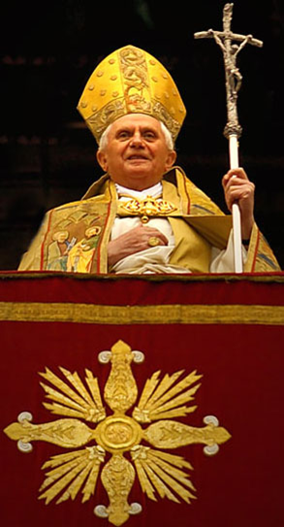
The beginnings of assumption were small
Power is cumulative
Eventually the pastors of Rome reached their fatal pre-eminence

Slide 17
Jeremiah 51: 7
Babylon hath been a golden cup in the LORD’s hand, that made all the earth drunken of her wine; therefore the nations are mad.

Slide 18
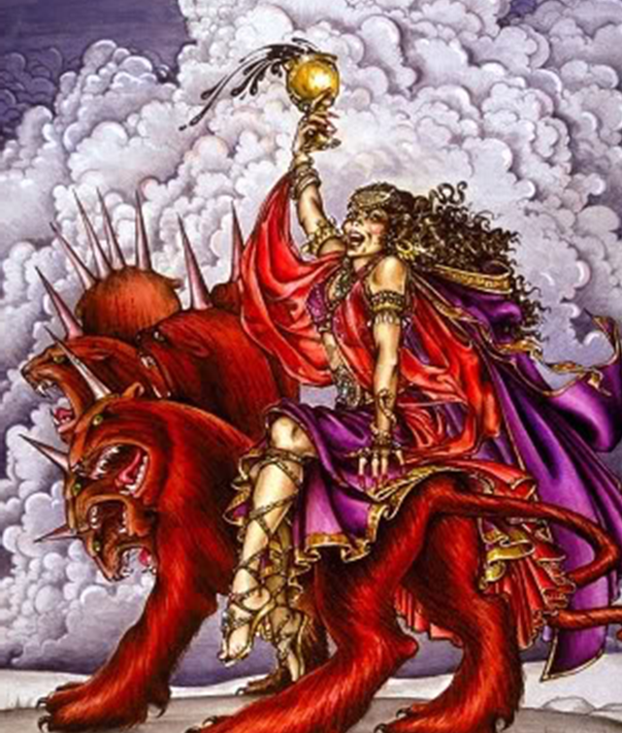
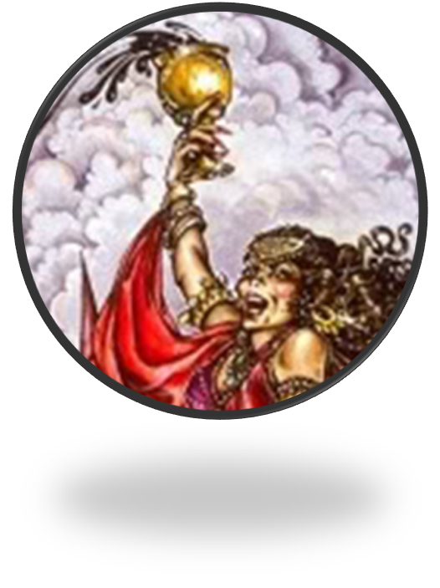
Revelation 17:4
And the woman was arrayed in purple and scarlet colour, and decked with gold and precious stones and pearls, having a golden cup in her hand full of the abominations and filthiness of her fornication.

Slide 19
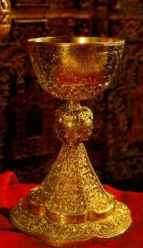
Reprint 5092
“The cup suggests that the unfaithful church…had once been the receptacle of divine truth.”
The woman eventually filled it with abominations and filthiness

Slide 20
Papacy survived early Christian persecution
and even prospered.
Satan protected and
nurtured his “new creation,”
much the same as our Heavenly Father is looking after His New Creation.

Slide 21
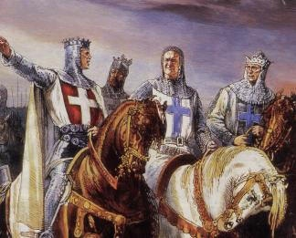
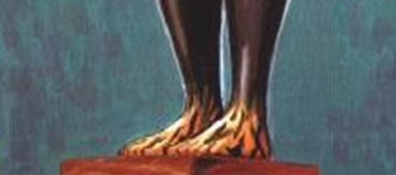
In 312 AD Constantine had a vision the night before the Battle of Milvian Bridge
He was told that he would win if he fought under the symbol of Christ.
The illicit union of the false church with the civil government was consummated
Iron & Clay
Mixed Kingdom

Slide 22
378 AD – Metropolitans empowered to judge the inferior clergy
Bishop of Rome (Pope Damasus) was empowered to judge the Metropolitans
Hierarchy was solidified.

Slide 23
“…the blinded nations mistook her for a god, and prostrated themselves in adoration.”

Slide 24
Middle Ages
Peasants and serfs.

Slide 25
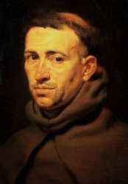
Your World
Armies were valued more than anything
Education exists only in the Catholic Church by becoming a Monk
All knowledge was from the Bible

Slide 26
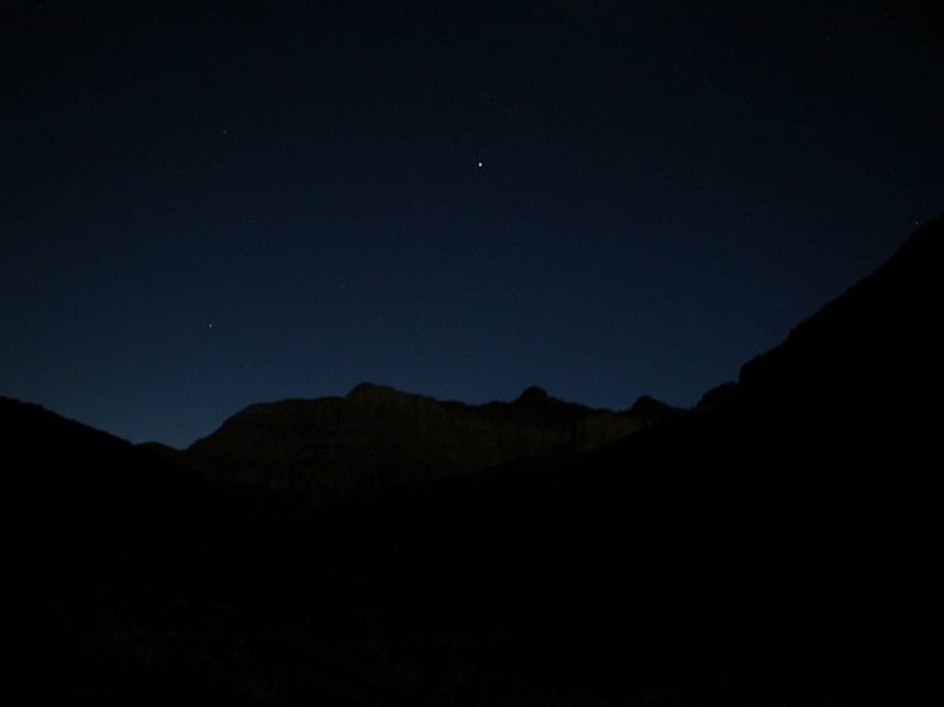
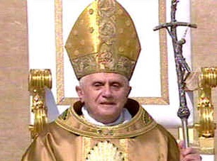
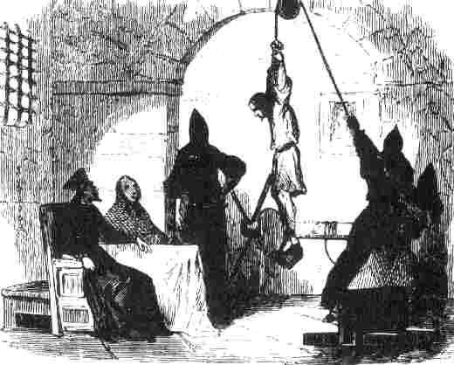
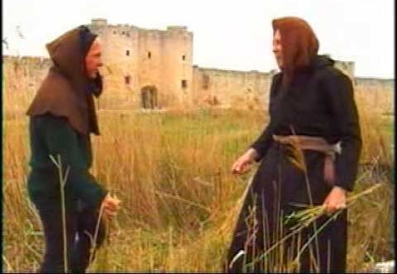
No democracy
No middle class
Iron hand
Huge class of poor

Slide 27
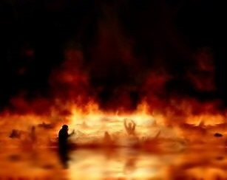
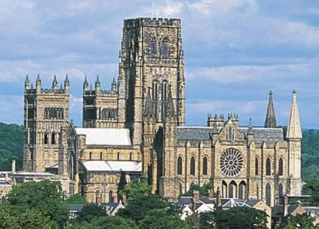
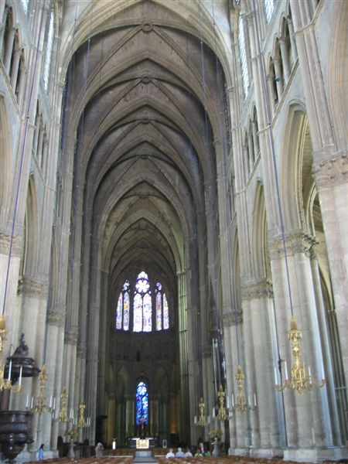
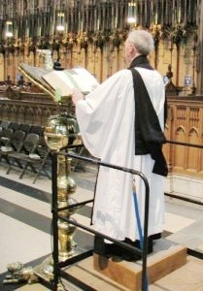
This must be from God. It is so wondrous. Surely this must be God’s throne.
If you didn’t give enough money, you would burn in hell, FOREVER!

Slide 28
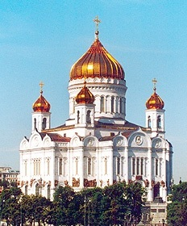
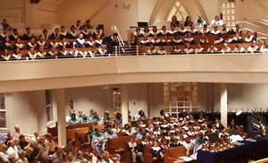
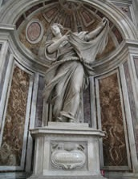
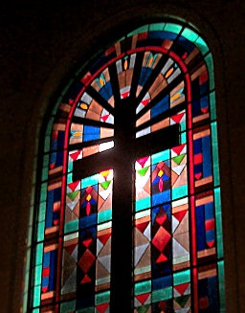
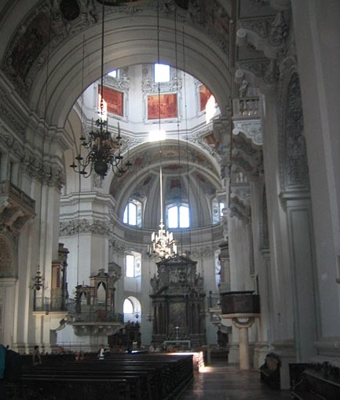
Marketing 101

Slide 29
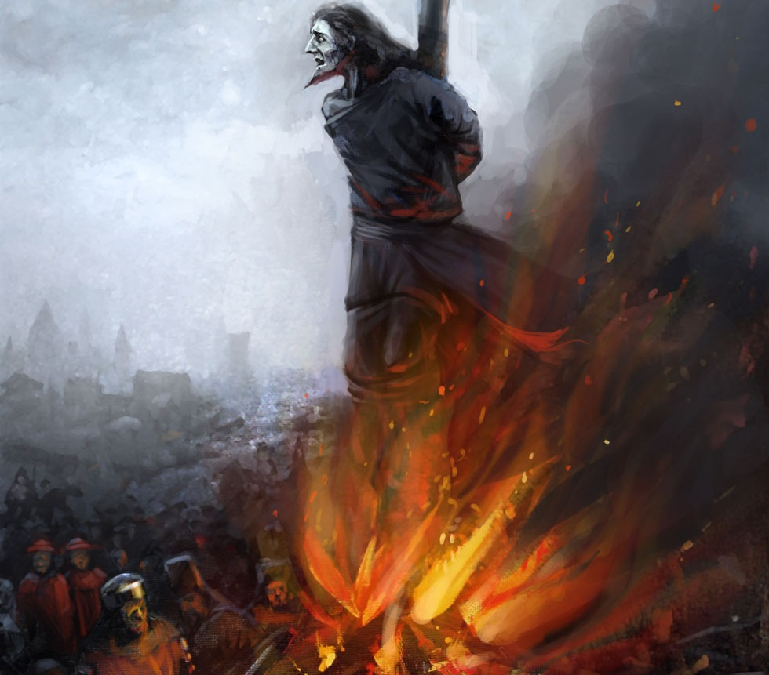
They did not question these things
They didn’t dare!

Slide 30
Cathedral
Latin word Cathedra. It means throne.
Whose throne?
Cathedral – The principle church of a bishop’s dioceses, containing the bishop’s throne.
Cathedra – A bishop’s official chair or throne.

Slide 31
Isaiah 66: 1 – Thus saith the LORD, The heaven is my throne, and the earth is my footstool: where is the house that ye build unto me? And where is the place of my rest?
Revelation 2:10 – Be thou faithful unto death and I will give thee a crown of life.

Slide 32
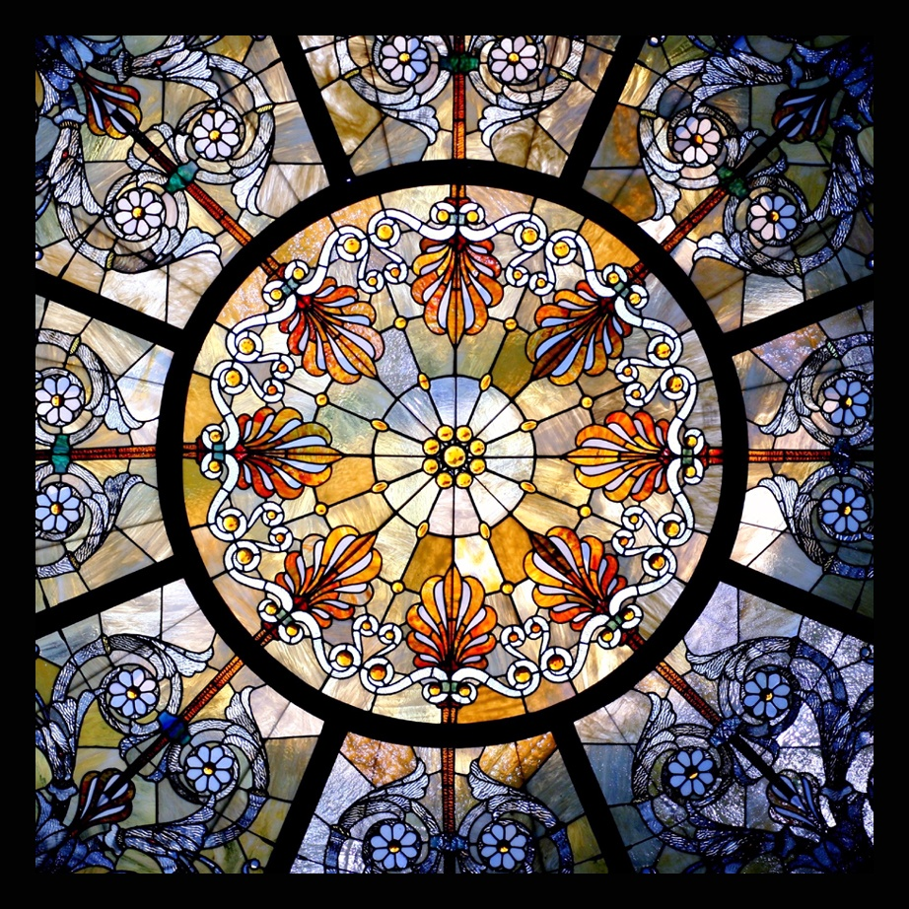

Slide 33
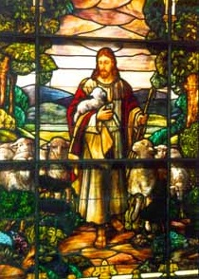
Exodus 20:4
Thou shalt not make unto thee any graven image, or likeness of anything that is in heaven above, or that is in the earth beneath, or that is in the water under the earth.

Slide 34
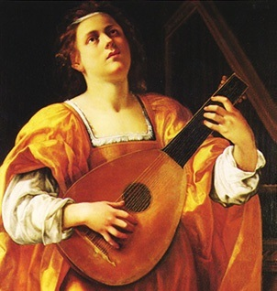
In the Dark Ages music was thought to be magic.
Many thought you could manipulate emotions with certain note patterns.
Gregorian Chant

Slide 35
Rhythm and meter developed at School of Notre Dame late 12th century.
Originally “…the beat had to be subdivided into threes, the symbol of the Trinity.” Music, An Appreciation – Roger Kamien

Slide 36
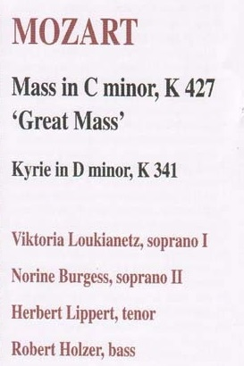
All the master composers of the day composed at least one Mass
Kyrie – Considered a most holy piece of music. It had three parts and each part was repeated three times.

Slide 37
Be sober, be vigilant; because your adversary the devil, as roaring lion walketh about, seeking whom he may devour.
1 Peter 5: 8
Revelation 5: 5 The lion of the Tribe of Judah.

Slide 38
Spain comes to the New World accompanied by Papal Priests.
“The Spanish believed they had a divine and royal mandate to reduce Indian peoples to submission.

Slide 39
“Spanish law required reading the Requerimiento to the Indians
Requerimiento: by theologians in 1513, required Indians ‘to acknowledge the Church as the Ruler and Superior of the whole world’, the Pope as high priest.
Doing so guaranteed Spain’s ‘love, charity, and leaving men, women, children, and lands free of servitude’.

Slide 40
“If you do not do this, and wickedly and intentionally delay to do so, I certify to you that, with the help of God, we shall forcibly enter into your country and shall make war against you in all ways and manners that we can, and shall subject you to the yoke and obedience of the Church and of their Highness; we shall take you and your wives and your children,

Slide 41
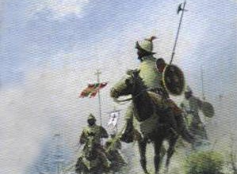
“and shall make slaves of them, and as such sell and dispose of them as their Highnesses may command…and we protest that the deaths and losses which shall accrue from this are your fault, and not that of their Highnesses, or ours, nor of these gentlemen who come with us.”

Slide 42
“The Requerimiento was read in Spanish to the Indians who could not understand it
It became a ‘ceremony of possession’
Allowed Spaniards to justify conquest – and atrocities.” First Peoples, Collin Calloway pp 69,70

Slide 43
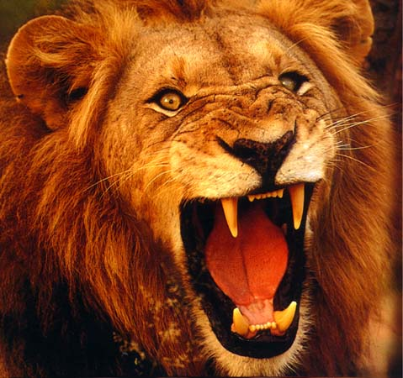
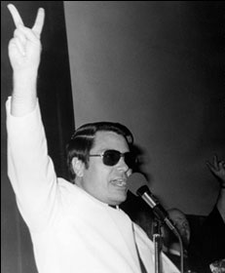
Did that sound like your God?
Did that sound like your brethren?
Jim Jones
“He who can make you believe absurdities, can make you commit atrocities.”
The lion was roaring and Satan’s plan was working

Slide 44
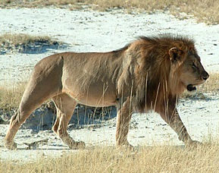
James 4: 7 - Submit yourselves therefore to God. Resist the devil, and he will flee from you.
“If a lion misses its quarry on the initial charge, it does not give pursuit, but quits and looks for new quarry.”

Slide 45
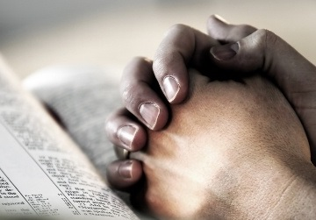
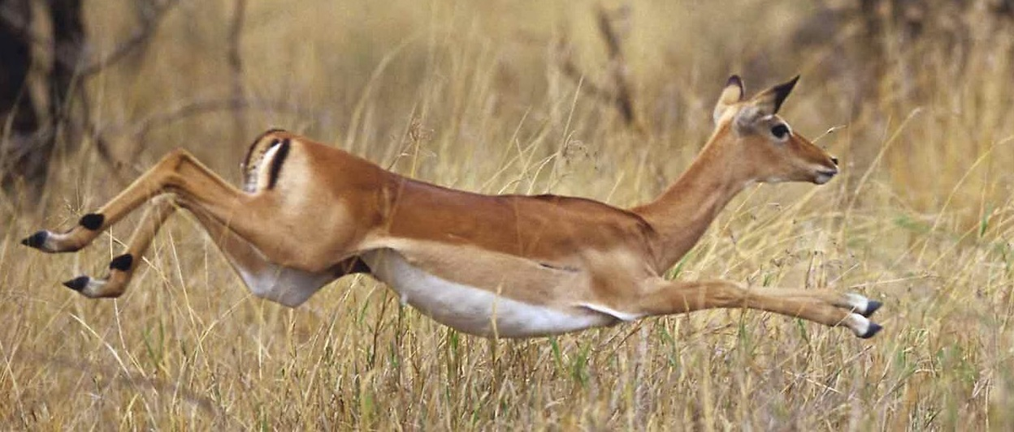
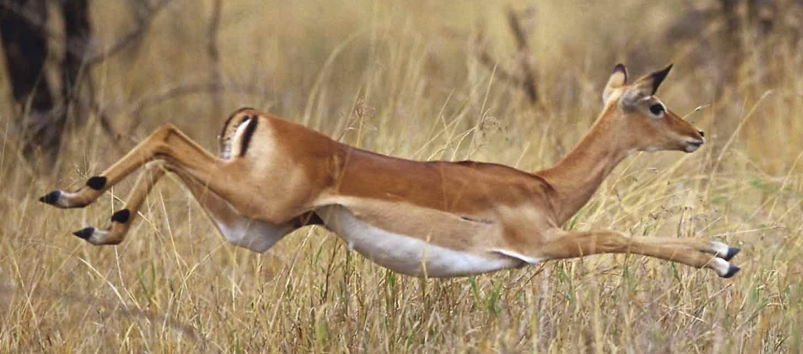
How do we resist the devil?
Pray for strength to resist temptation and for increased faith
Study to have sound scriptural answers. Remember Satan did flee when Jesus gave scriptural answers in the wilderness

Slide 46
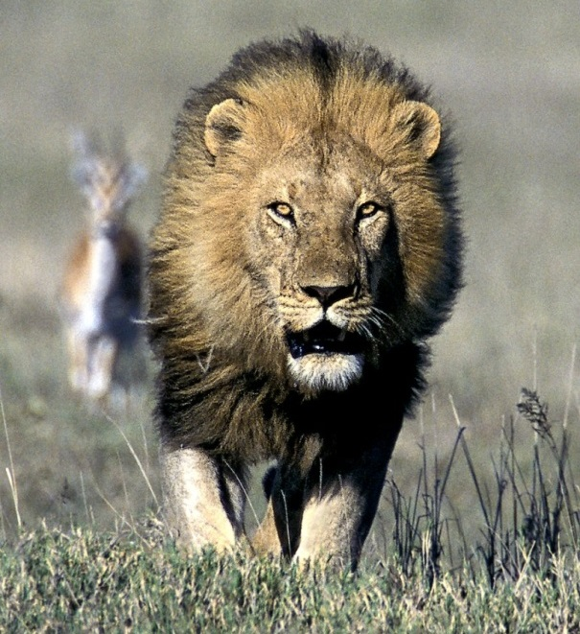
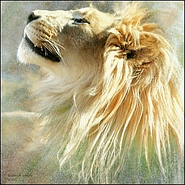
“Lions are not particularly efficient hunters, they capture their prey only 20 to 30% of the time.”
“Lions do not hunt by scent, although their sense of smell is excellent…”

Slide 47
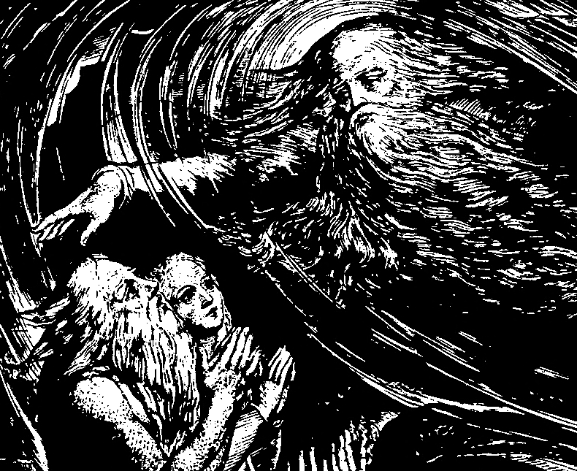
Hebrews 2:14 – Him that had the power of death, that is, the devil…
The LORD said to Satan in Job 2:6 – Behold, he is in thine hand; but save his life.
Our assurance? 1 John 5:18 …he that is begotten of God keepeth himself, and that wicked one toucheth him not

Slide 48
Lions often hunt in the dark.
Satan and his minions are hunting for you and for me.
Keep yourselves in the love of God… Jude 21

Slide 49
The Lion of the Tribe of Judah
Mating lions are not interested in hunting or eating, pose no threat
During the Gospel Age Christ has been developing His bride for a future marriage and has posed no threat to Satan

Slide 50
Genesis 49: 9 & 10 Like a lions whelp, O Judah, from the prey, my son, thou risest…
From Judah the whelp, came Christ the lion

Slide 51
Two lions, one is an imposter in disguise.

Slide 52
Jesus the, lamb of God, was sent to the house of Israel
Israel killed the Lamb

Slide 54
When did Jesus become the lion?
Matthew 28: 18 - And Jesus came and spake unto them, saying, All power is given unto me in heaven and in earth.
A lamb has the power to feed after it has been killed
Jesus feeds us daily

Slide 55
What about the lamb?
Revelation 19: 7 – Marriage to bride
Revelation 21: 9 – Lamb’s wife
Revelation 22: 3 – And there shall be no more curse: but the throne of God and of the Lamb shall be in it

Slide 56
Isaiah 11: 6 – The wolf also shall dwell with the lamb, and the leopard shall lie down with the kid; and the calf and the young lion and the fatling together

Slide 57
Jesus will be the conquering King
Isaiah 28:17 Judgment also will I lay to the line, and righteousness to the plummet
And He will be a sympathetic High Priest

Slide 58
Satan (Lucifer) lost his position as the “morning star”
Satan did not want anything to do with the lamb-like traits, he only wanted power

Slide 60
Revelation 22: 16 – I Jesus…am the root and the offspring of David, and
the bright and morning star

Slide 61
We want to navigate the clear, pure waters of truth. It doesn’t matter how it appears to outside observers.

Slide 62
How blessed we are:
-To see the true light
-To have a relationship with the Lion of the Tribe of Judah
-To know that soon Satan will no longer deceive the nations
May the LORD add His blessing

